Slide 1
DTW Subset
BAE LAB.
Department of Industrial Engineering, Pusan National University

Slide 2
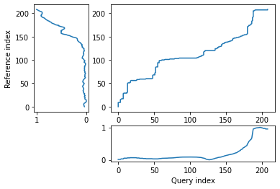
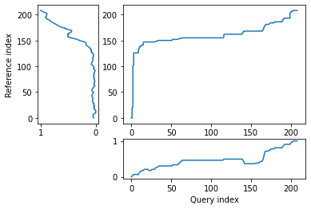
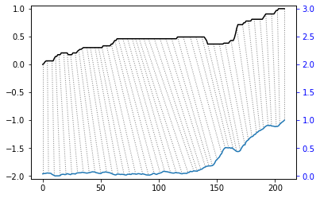
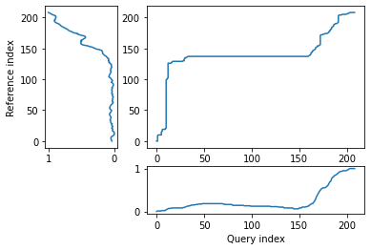
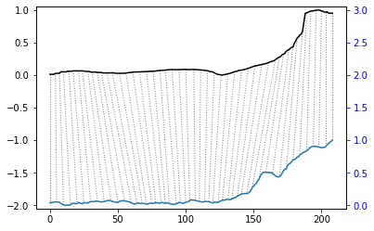
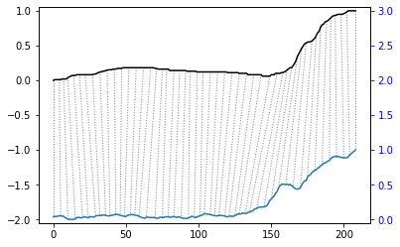
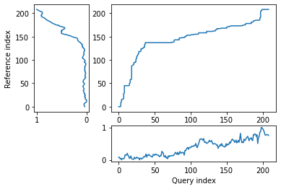
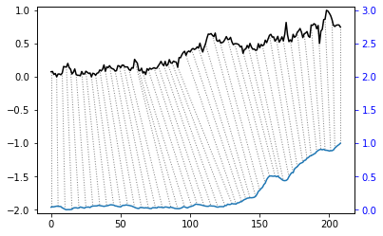
Dynamic Time Warping (2018) (20%)
알고리즘 적용
Average Earnings : 3.789
Newbuilding Prices(3500,4000 TEU) : 5.245
1
2
Newbuilding Prices(13000,13500 TEU): 6.732
PCI-Comprehensive: 10.623
3
4

Slide 3
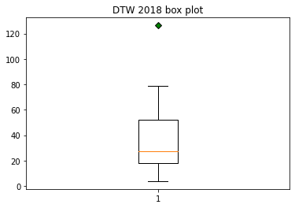
Reason for making subset
근거
상재 형께서 말씀해주신 20% 기준으로 분리

Slide 4
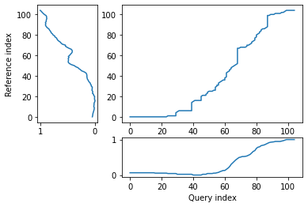
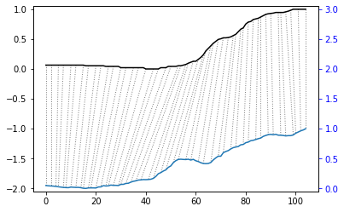
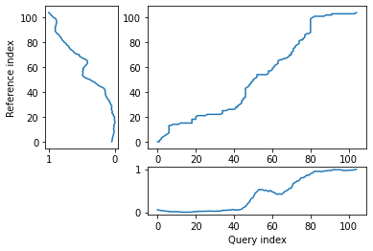
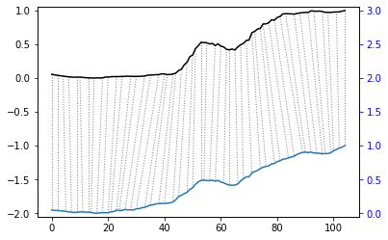
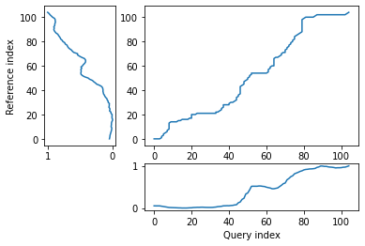
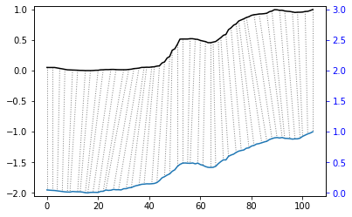
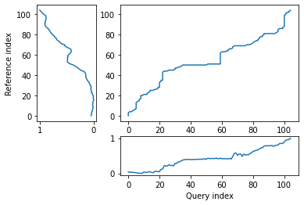
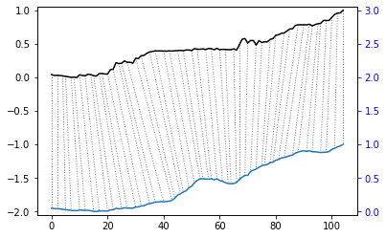
Dynamic Time Warping (2020) (20%)
알고리즘 적용
Newbuilding Prices(13000,13500 TEU): 1.64
SCFI-Europe (base port) : 1.68
1
2
SCFI-Med (base port) : 1.82
SCFI-WC America (base port) : 2.43
3
4

Slide 5
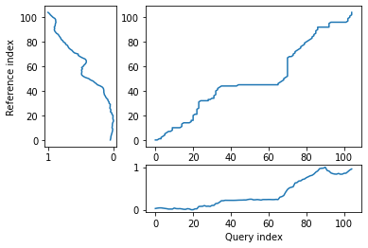
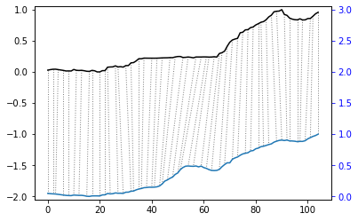
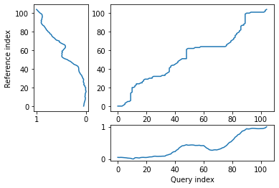
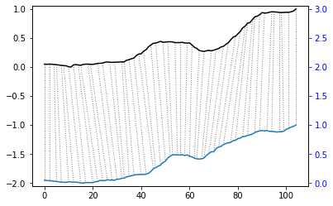
Dynamic Time Warping (2020) (20%)
알고리즘 적용
SCFI-EC America (base port): 2.63
SCFI-ANZ (Melbourne) : 2.97
5
6

Slide 6
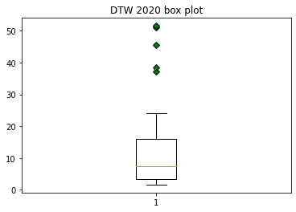
Reason for making subset
근거
상재 형께서 말씀해주신 20% 기준으로 분리

Slide 7
Q&A

